Slide 1
Fresh Grads – Group Project
Online Vehicle Rental Management

Slide 2
Problem Statement
To Create an application which provides provision for customers to book vehicle and get it delivered or collect the vehicle from the company.
Administrator can add/modify the vehicle details, approve / reject the vehicles to the customers, view vehicles, view customers, view booking requests, view details of vehicles rented and payment details.
It also keeps track of number of vehicles rented and the payment details. This application also provides status booking where the customer can see the whether their booking is accepted or rejected

Slide 3
Road Map
Application will be developed in following Sprints –
Core Java +JPA with Hibernate
Spring Boot + Rest Controller + JPA with Hibernate
Angular for UI design (Front End) + Integration with previous Sprint

Slide 4
Plan
Design
Generate the skeleton as per class design provided
TDD approach
Identify test cases for each module
Write Failing Test cases
Convert the Test Cases in GREEN
Implement the case study in incremental manner

Slide 5
Modules
Admin Module
Customer Module
Vehicle Module
Payment Module
Booking Module
Active Booking Module

Slide 6
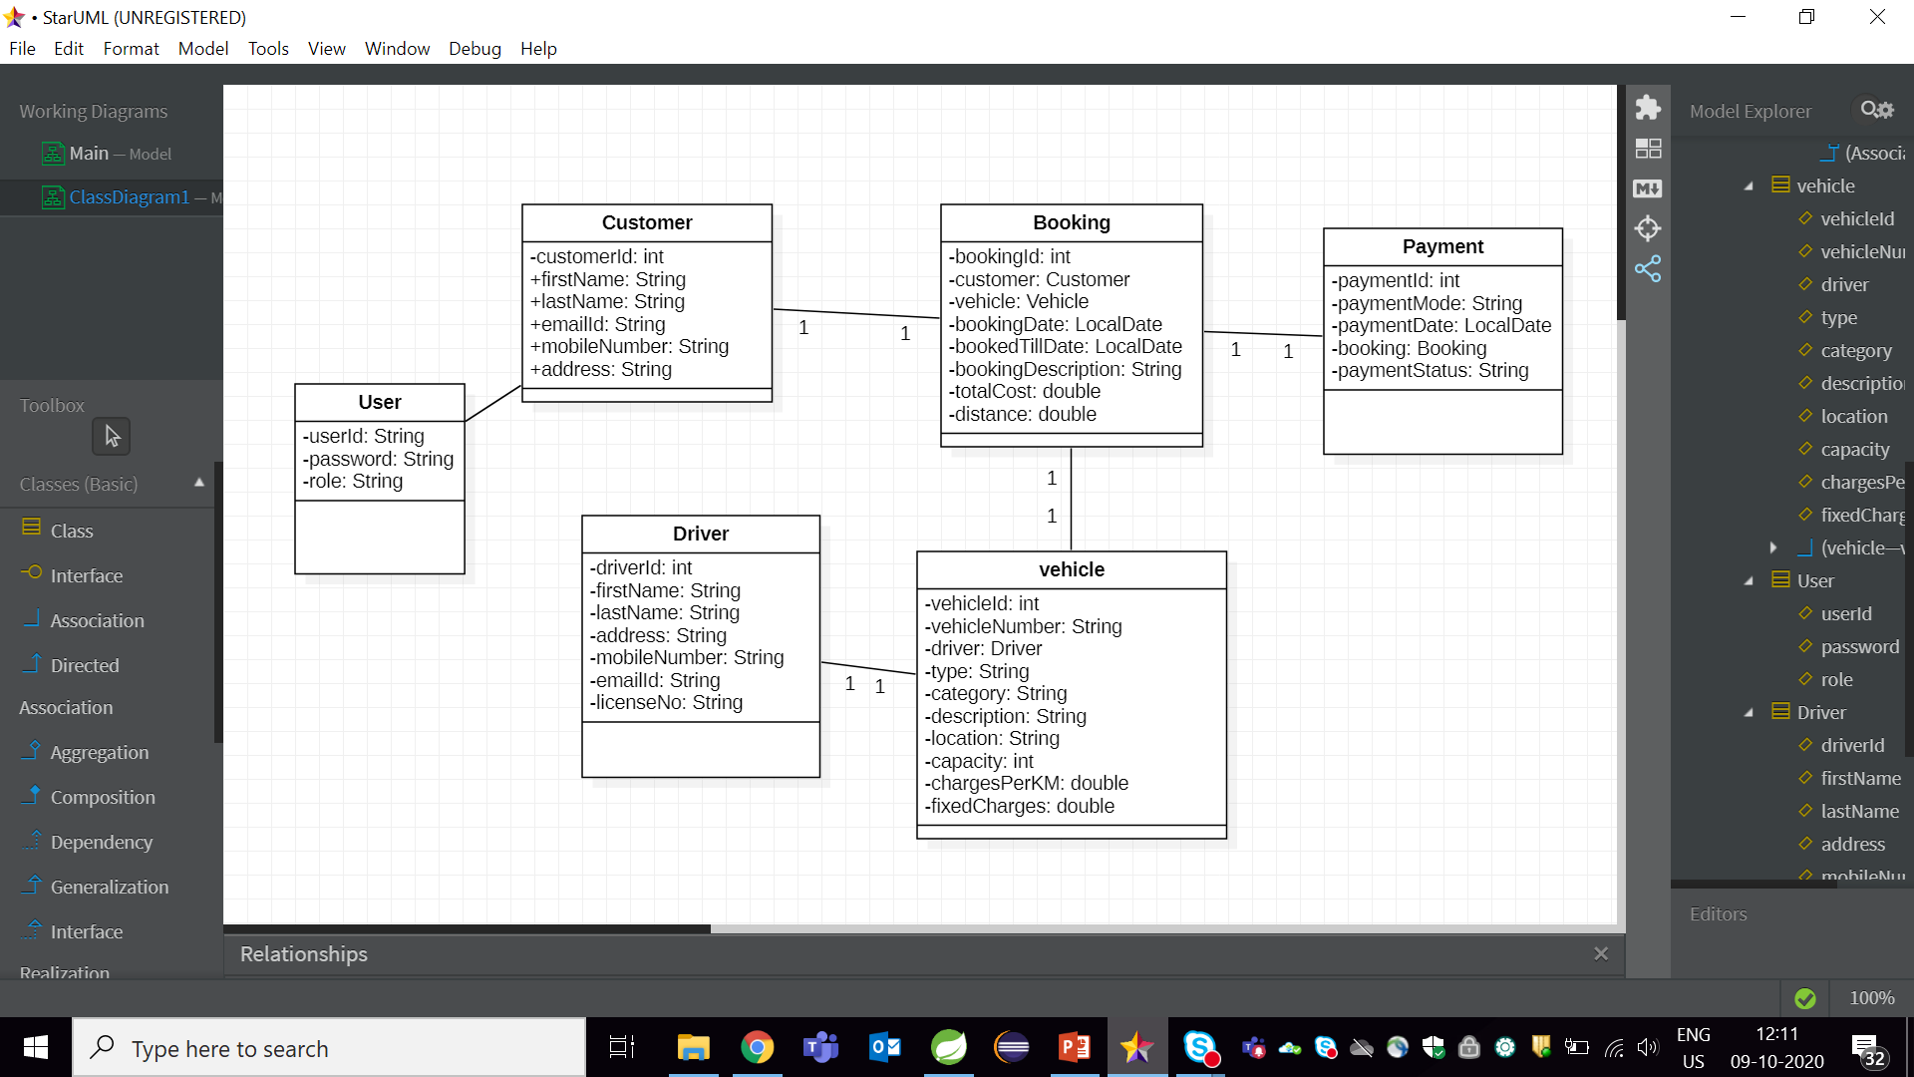
Class Design
POJO Classes:

Slide 7
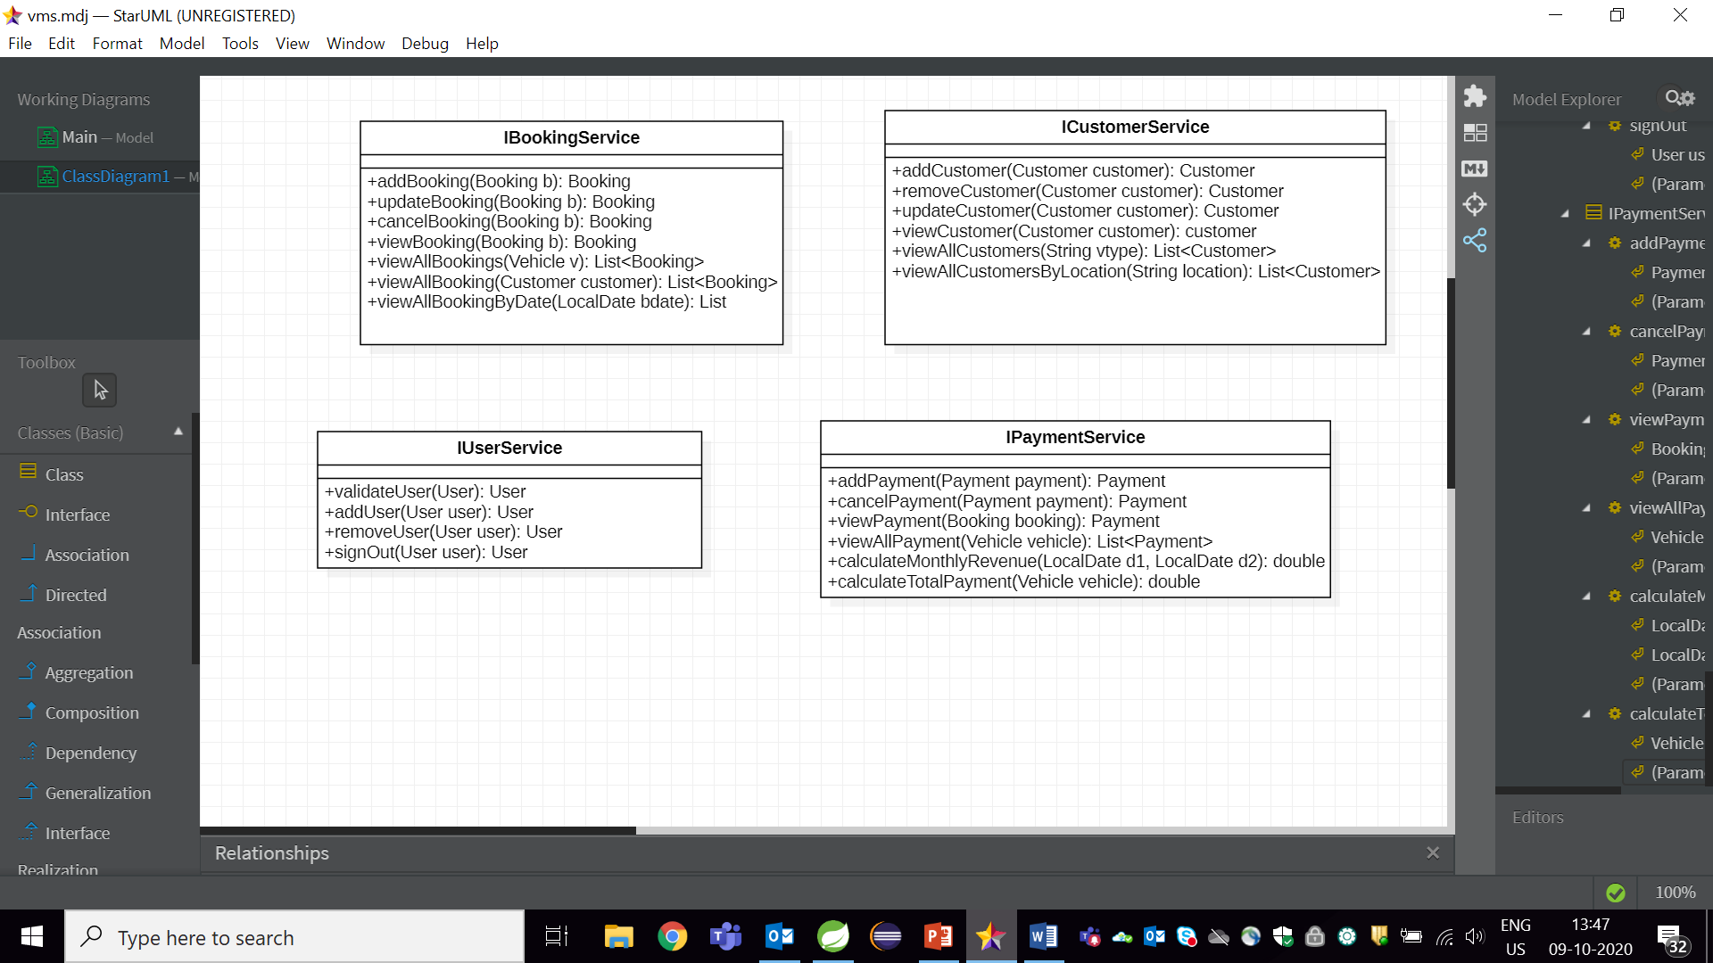
Class Design
Service Interface:

Slide 8

Class Design
Repository:

Slide 9




Questions

